Slide 1



AutoRestTest
An AI-Powered Platform for Automated REST API Testing
Mohammad Ismail Hossain
BSSE 1433
Supervised by: Toukir Ahammed

Slide 2
Project Overview
An AI-powered web platform that turns an OpenAPI specification into a complete, automatically generated and executed REST API test suite.
HOW IT WORKS
1
📄
2
🤖
3
📊
Upload API Spec
AI Generates & Runs Tests
Get Actionable Reports
Import an OpenAPI 3.0 file to define the target API.
Cooperating AI agents explore the API and adapt from every response.
Coverage, status-code breakdown, and detected server errors.
POWERED BY
🎯
Multi-Agent RL
🔗
Semantic Dependency Graph
✨
LLM-Driven Inputs
Agents learn the optimal testing strategy.
Generates realistic, schema-valid values.
Discovers links between API operations.
BUILT WITH
Next.js
NestJS
PostgreSQL
Python
MARL + LLM
1

Slide 3
Functional Requirements - Normal
🔐
📁
📄
User Authentication
Project Management
Specification Upload
Secure sign-up, login, and role-based access.
Create and organize API testing projects.
Import an OpenAPI 3.0 spec to define the API.
▶️
📊
🔔
Test Execution
Result Viewing
Completion Notifications
Run AI-generated tests against the target API.
Inspect requests, responses, and outcomes.
Get notified when a test run finishes.
2

Slide 4
Functional Requirements - Expected
🤖
💾
🕐
Automatic Suite Generation
Save & Reuse Suites
Execution History
Persist test suites to re-run them anytime.
Track every past run for each project.
AI builds test cases directly from the spec.
📈
⬇️
👥
Reports & Analytics
Export Reports
Team Collaboration
Coverage and status-code insights per run.
Download results as a shareable PDF.
Invite members with role-based permissions.
3

Slide 5
Functional Requirements - Exciting
✨
⚡
🧠
Automated Spec Generation
One-Click End-to-End Testing
AI-Powered Failure Explanation
Generate an OpenAPI specification from a codebase using AI.
A single action runs the entire testing pipeline for you.
Plain-language explanations of why a test failed.
4

Slide 6
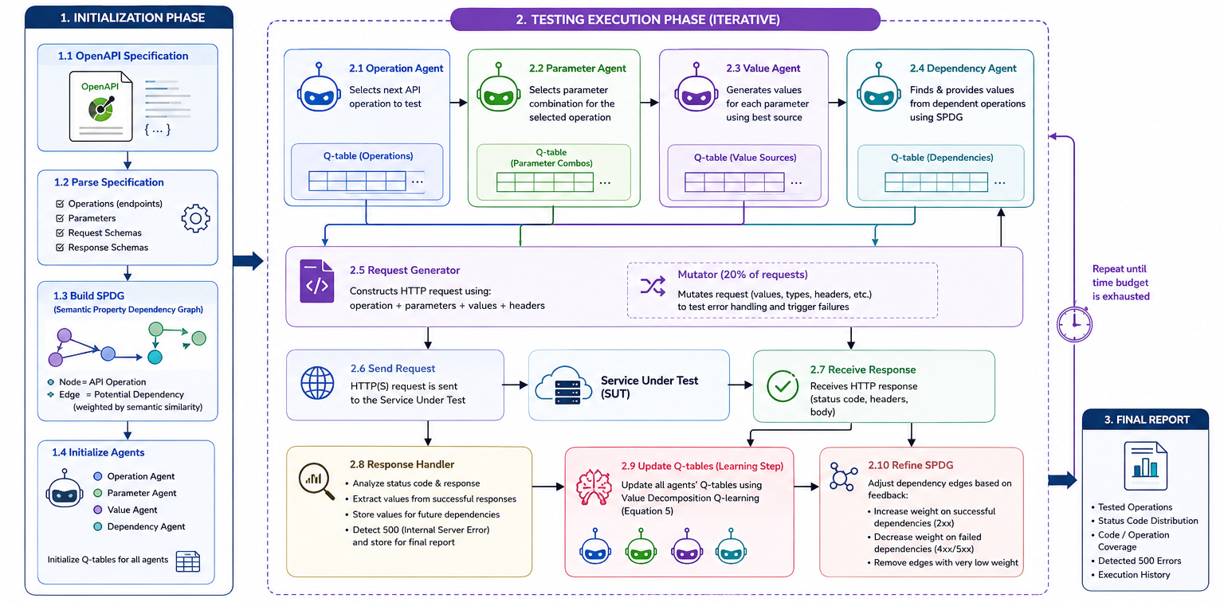
AutoRestTest Workflow
5

Slide 7
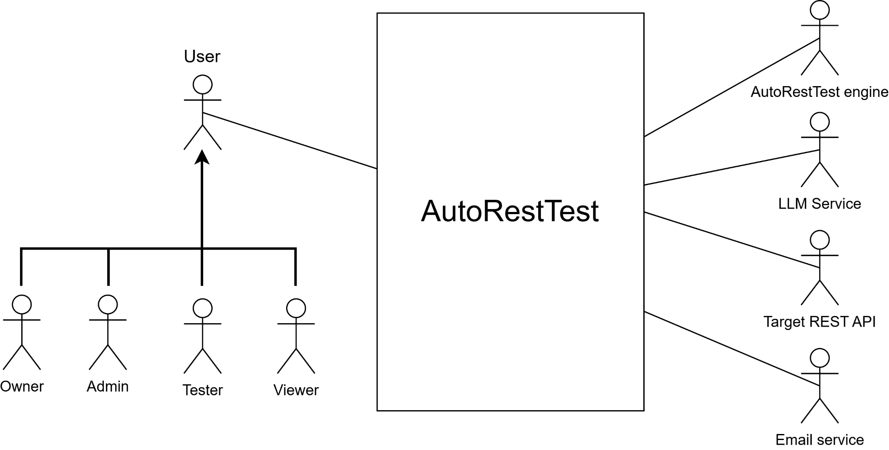
Use Case Level 0
6

Slide 8
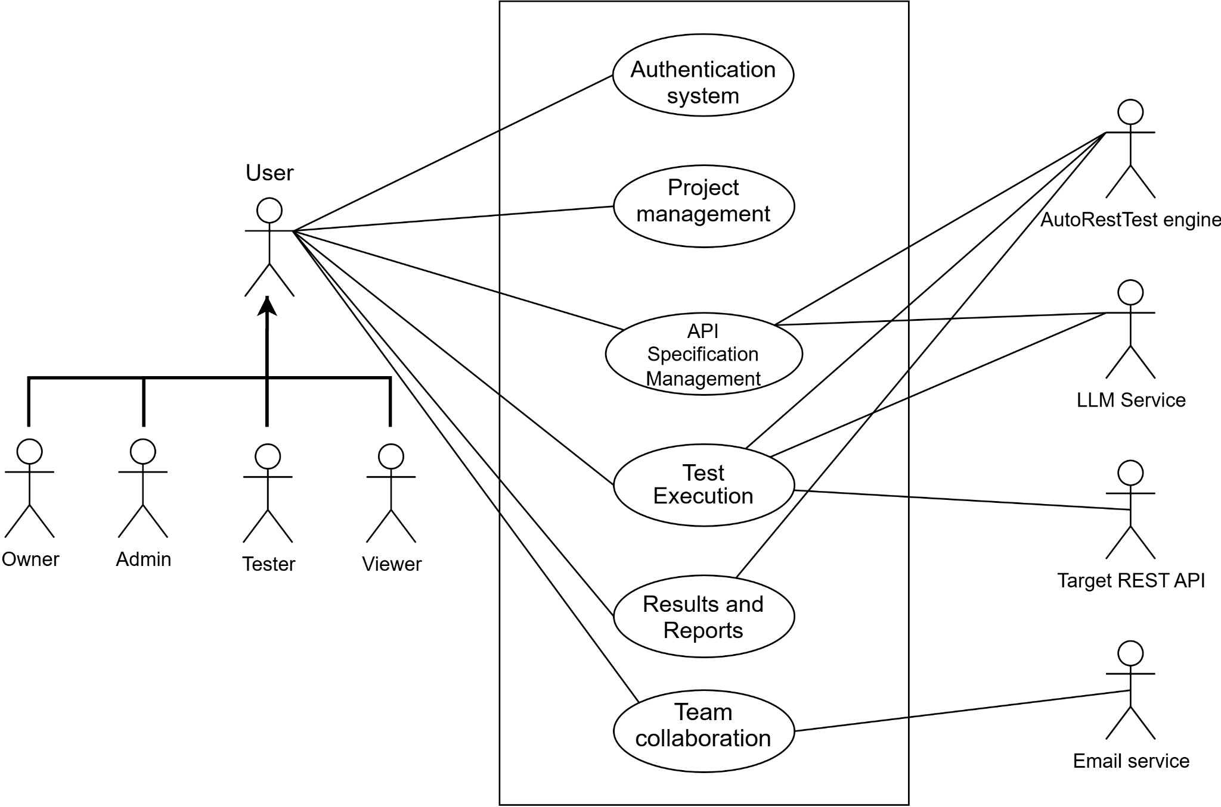
Use Case Level 1
7

Slide 9
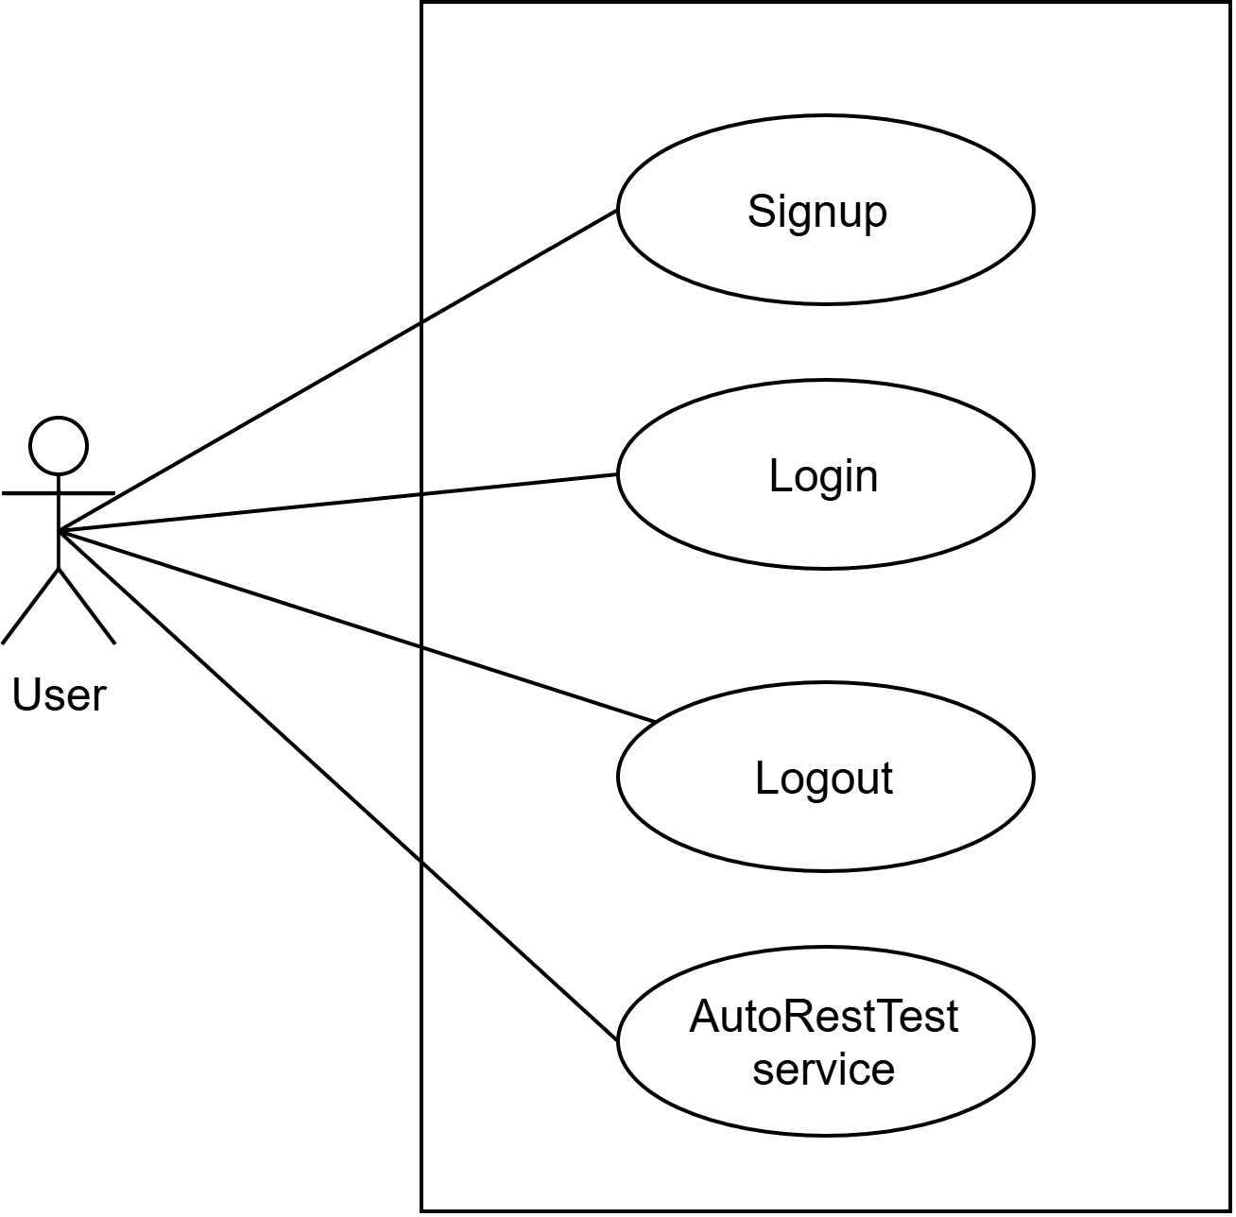
Use Case Level 1.1 - Authentication
8

Slide 10
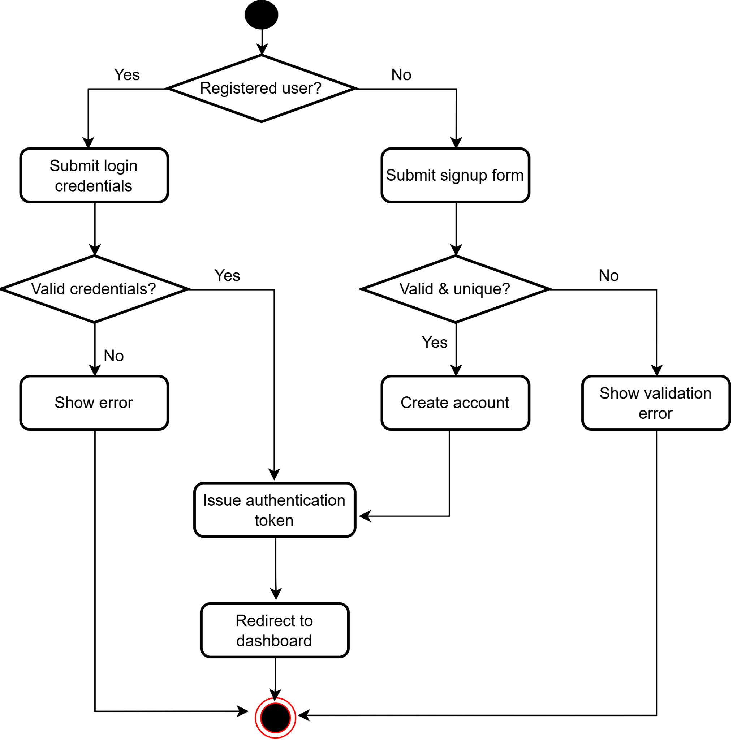
Activity Diagram Level 1.1 - Authentication
9

Slide 11
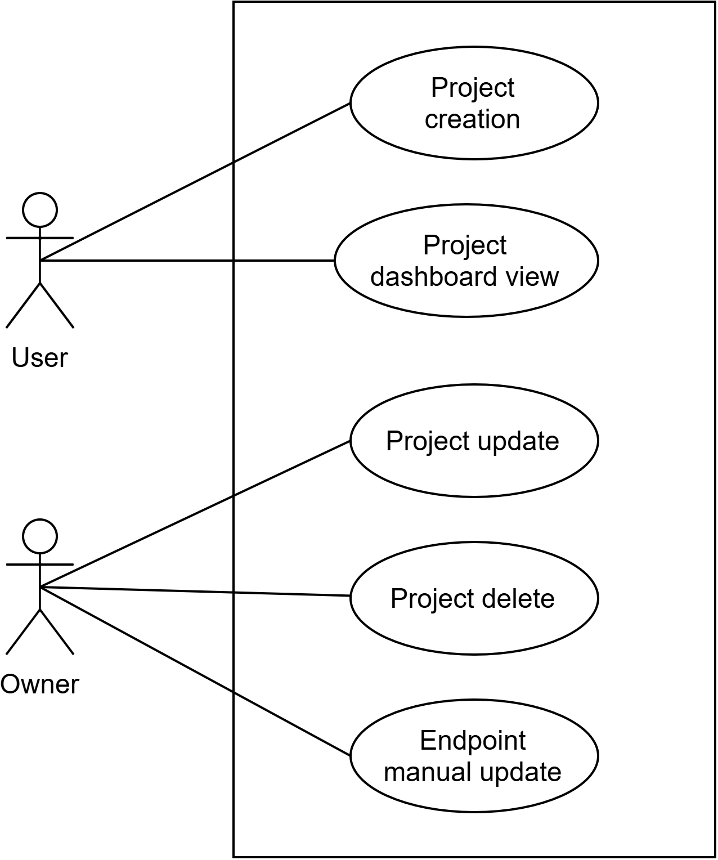
Use Case Level 1.2 - Project Management
10

Slide 12
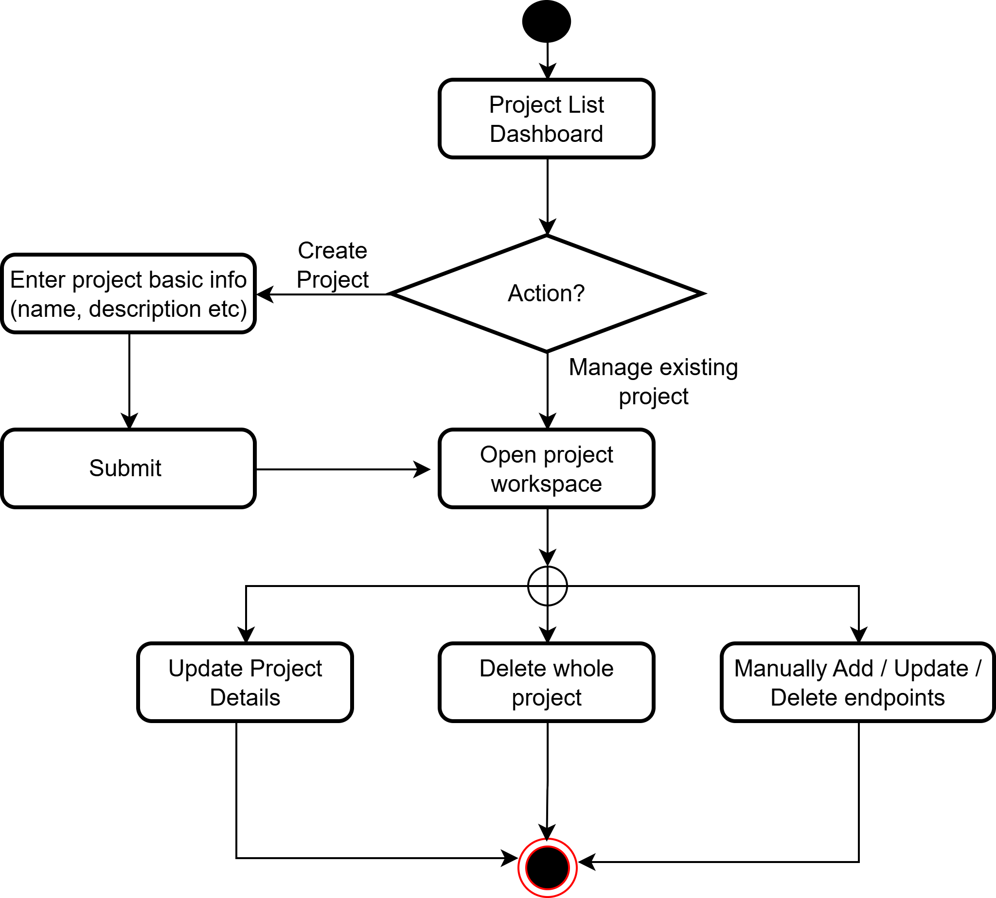
Activity Diagram Level 1.2 - Project Management
11

Slide 13
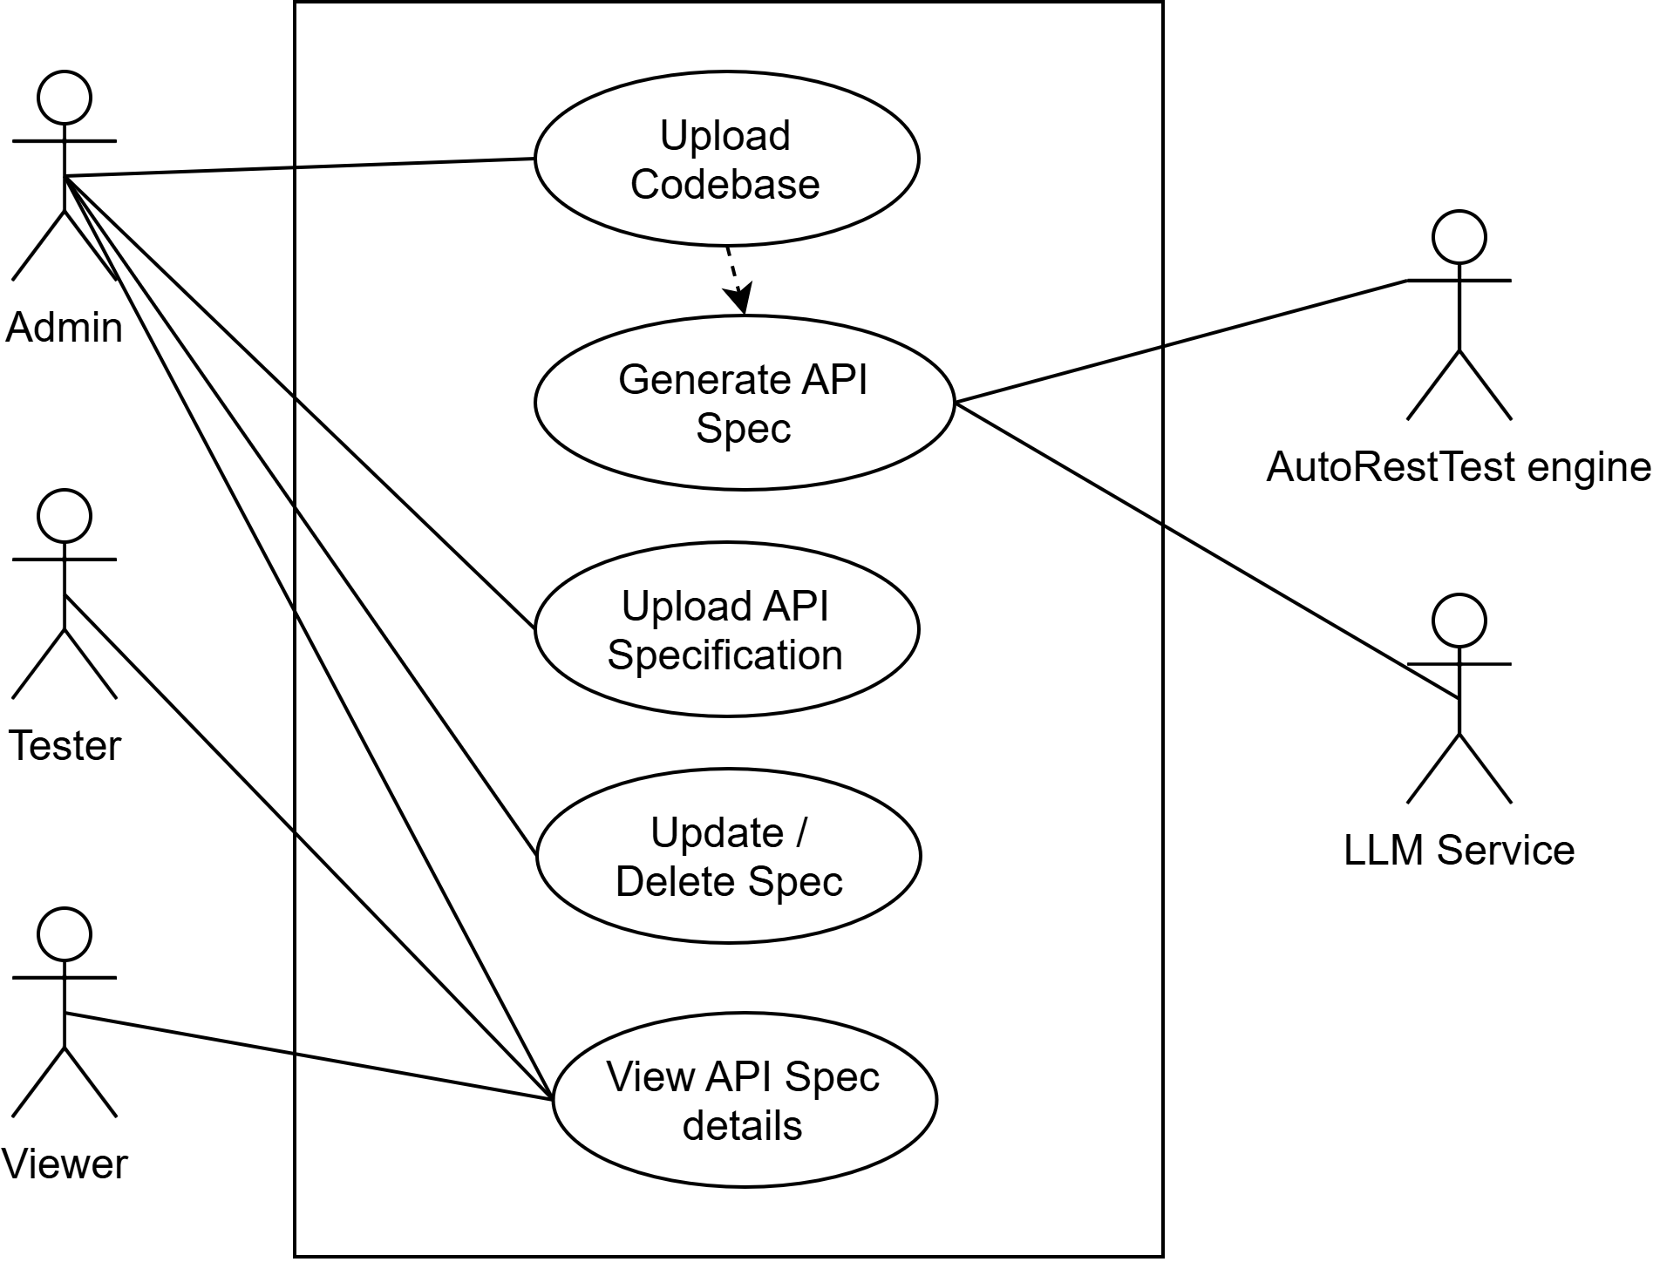
Use Case Level 1.3 - API Specification Management
12

Slide 14
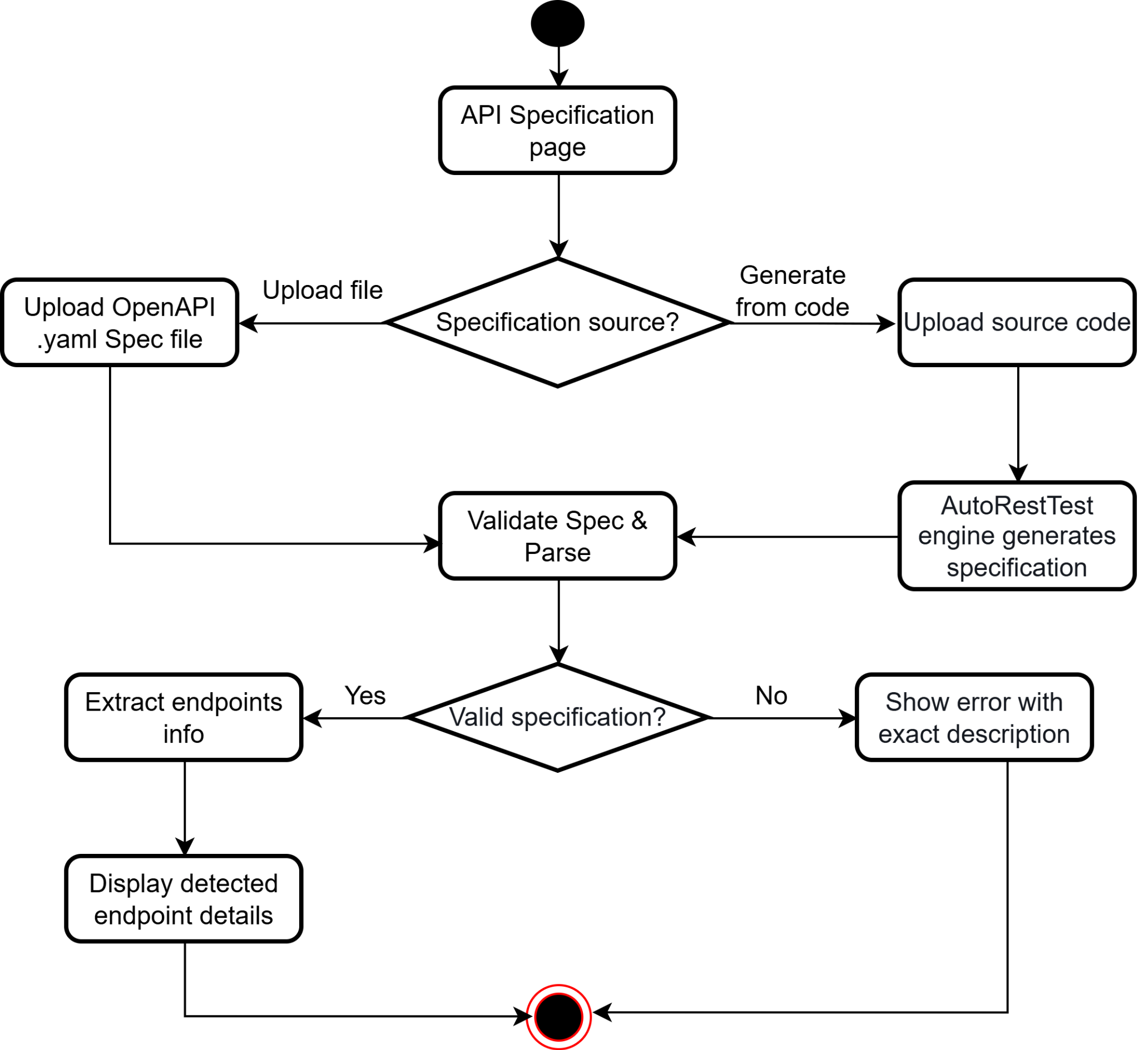
Activity Diagram Level 1.3 - API Specification Management
13

Slide 15
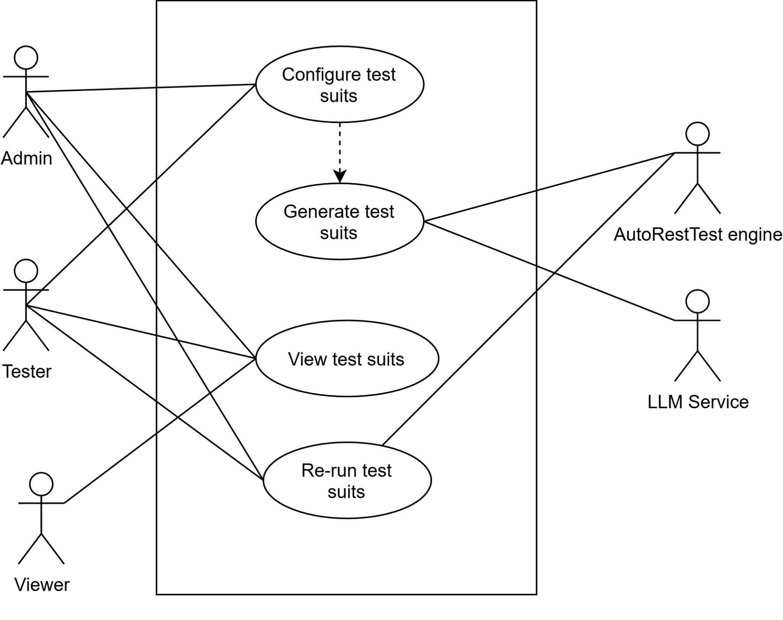
Use Case Level 1.4 - Test Suite Management
14

Slide 16
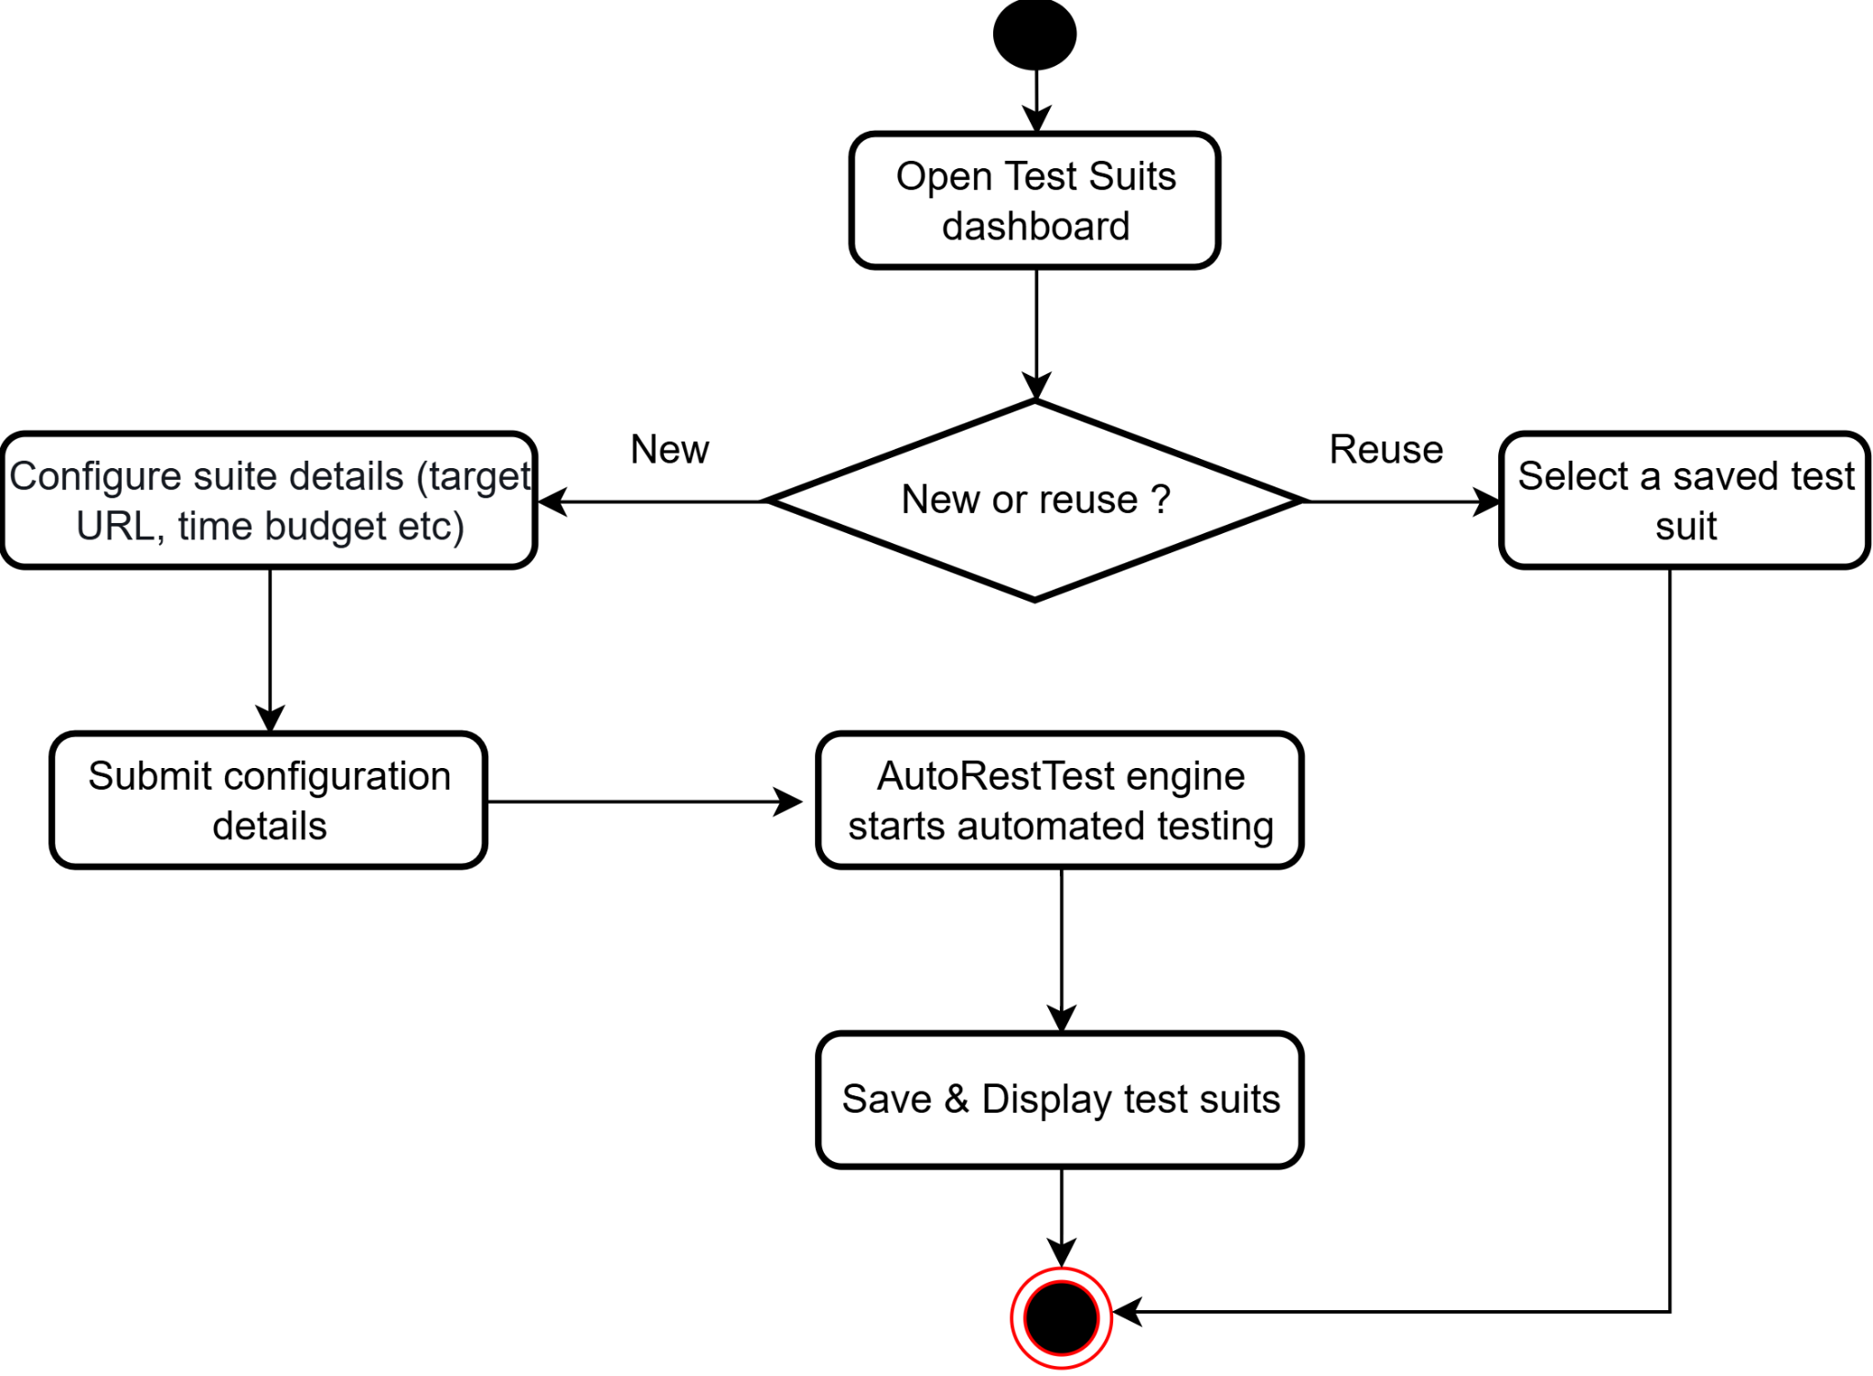
Activity Diagram Level 1.4 -Test Suite Management
15

Slide 17
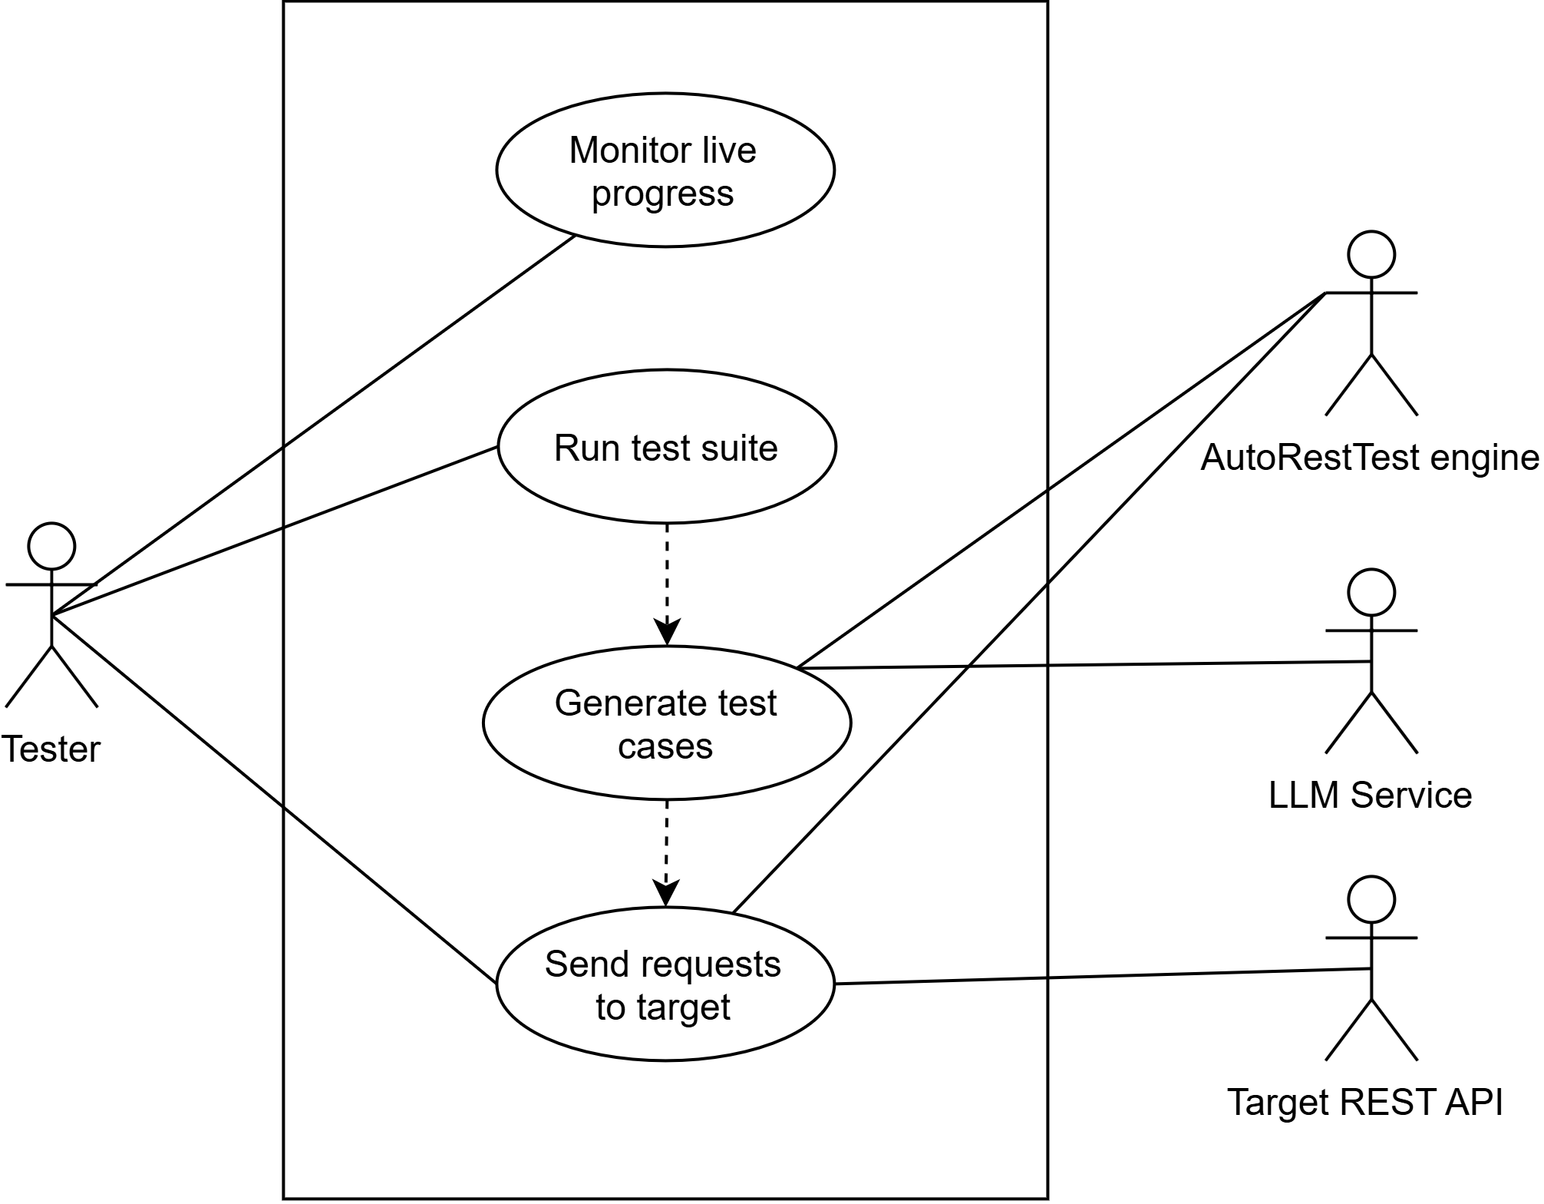
Use Case Level 1.5 - Test Execution
16

Slide 18
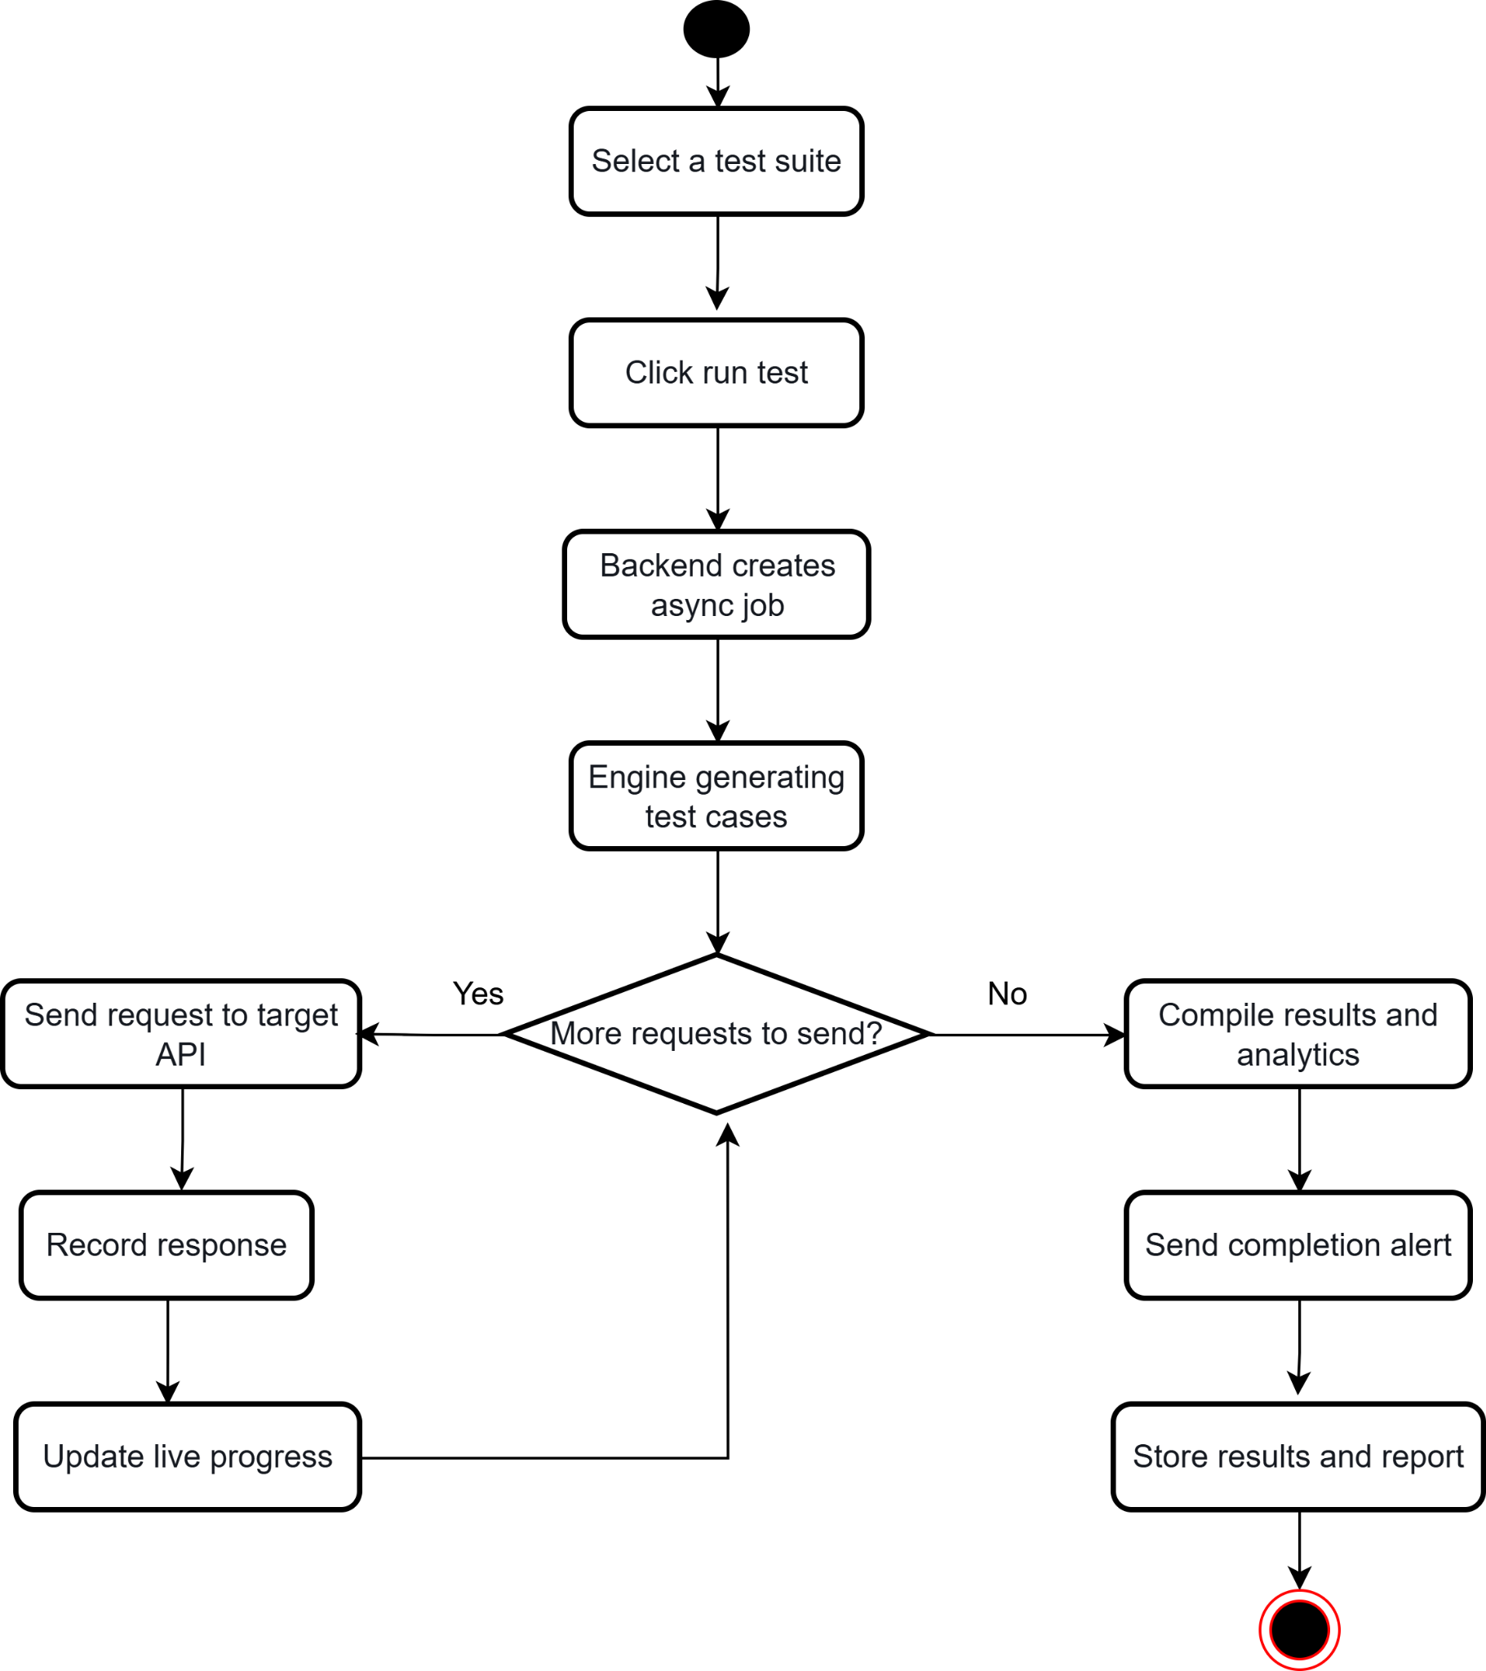
Activity Diagram Level 1.5 - Test Execution
17

Slide 19
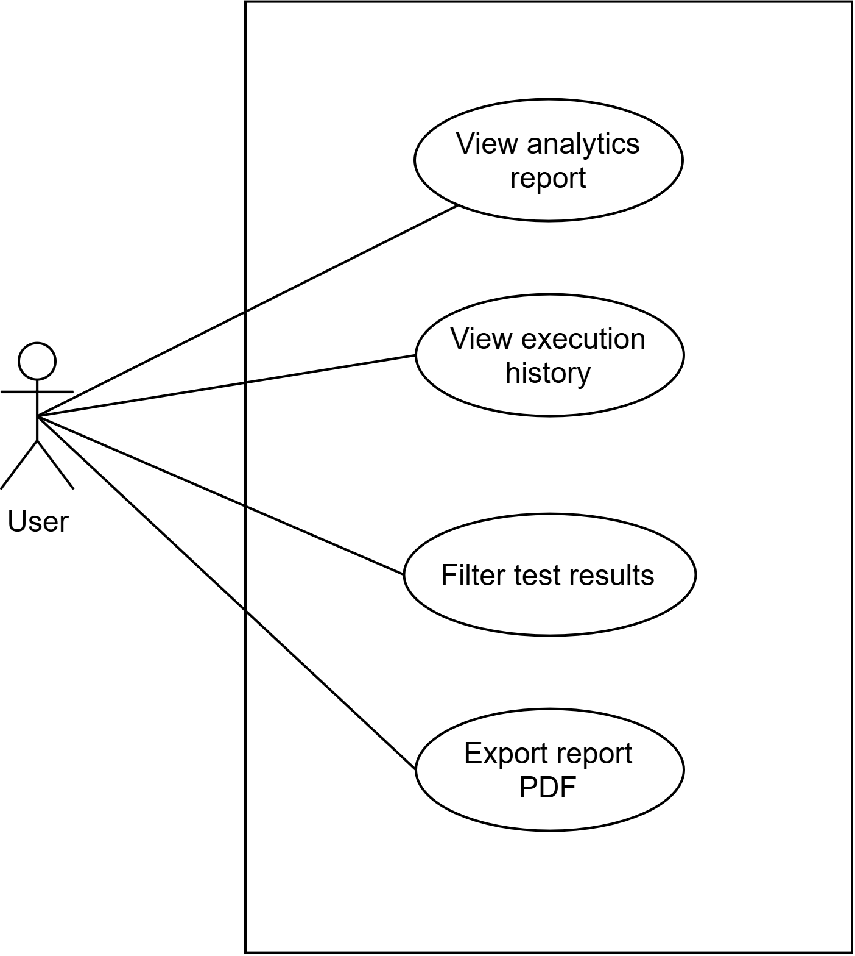
Use Case Level 1.6 - Test Results & Reports
18

Slide 20
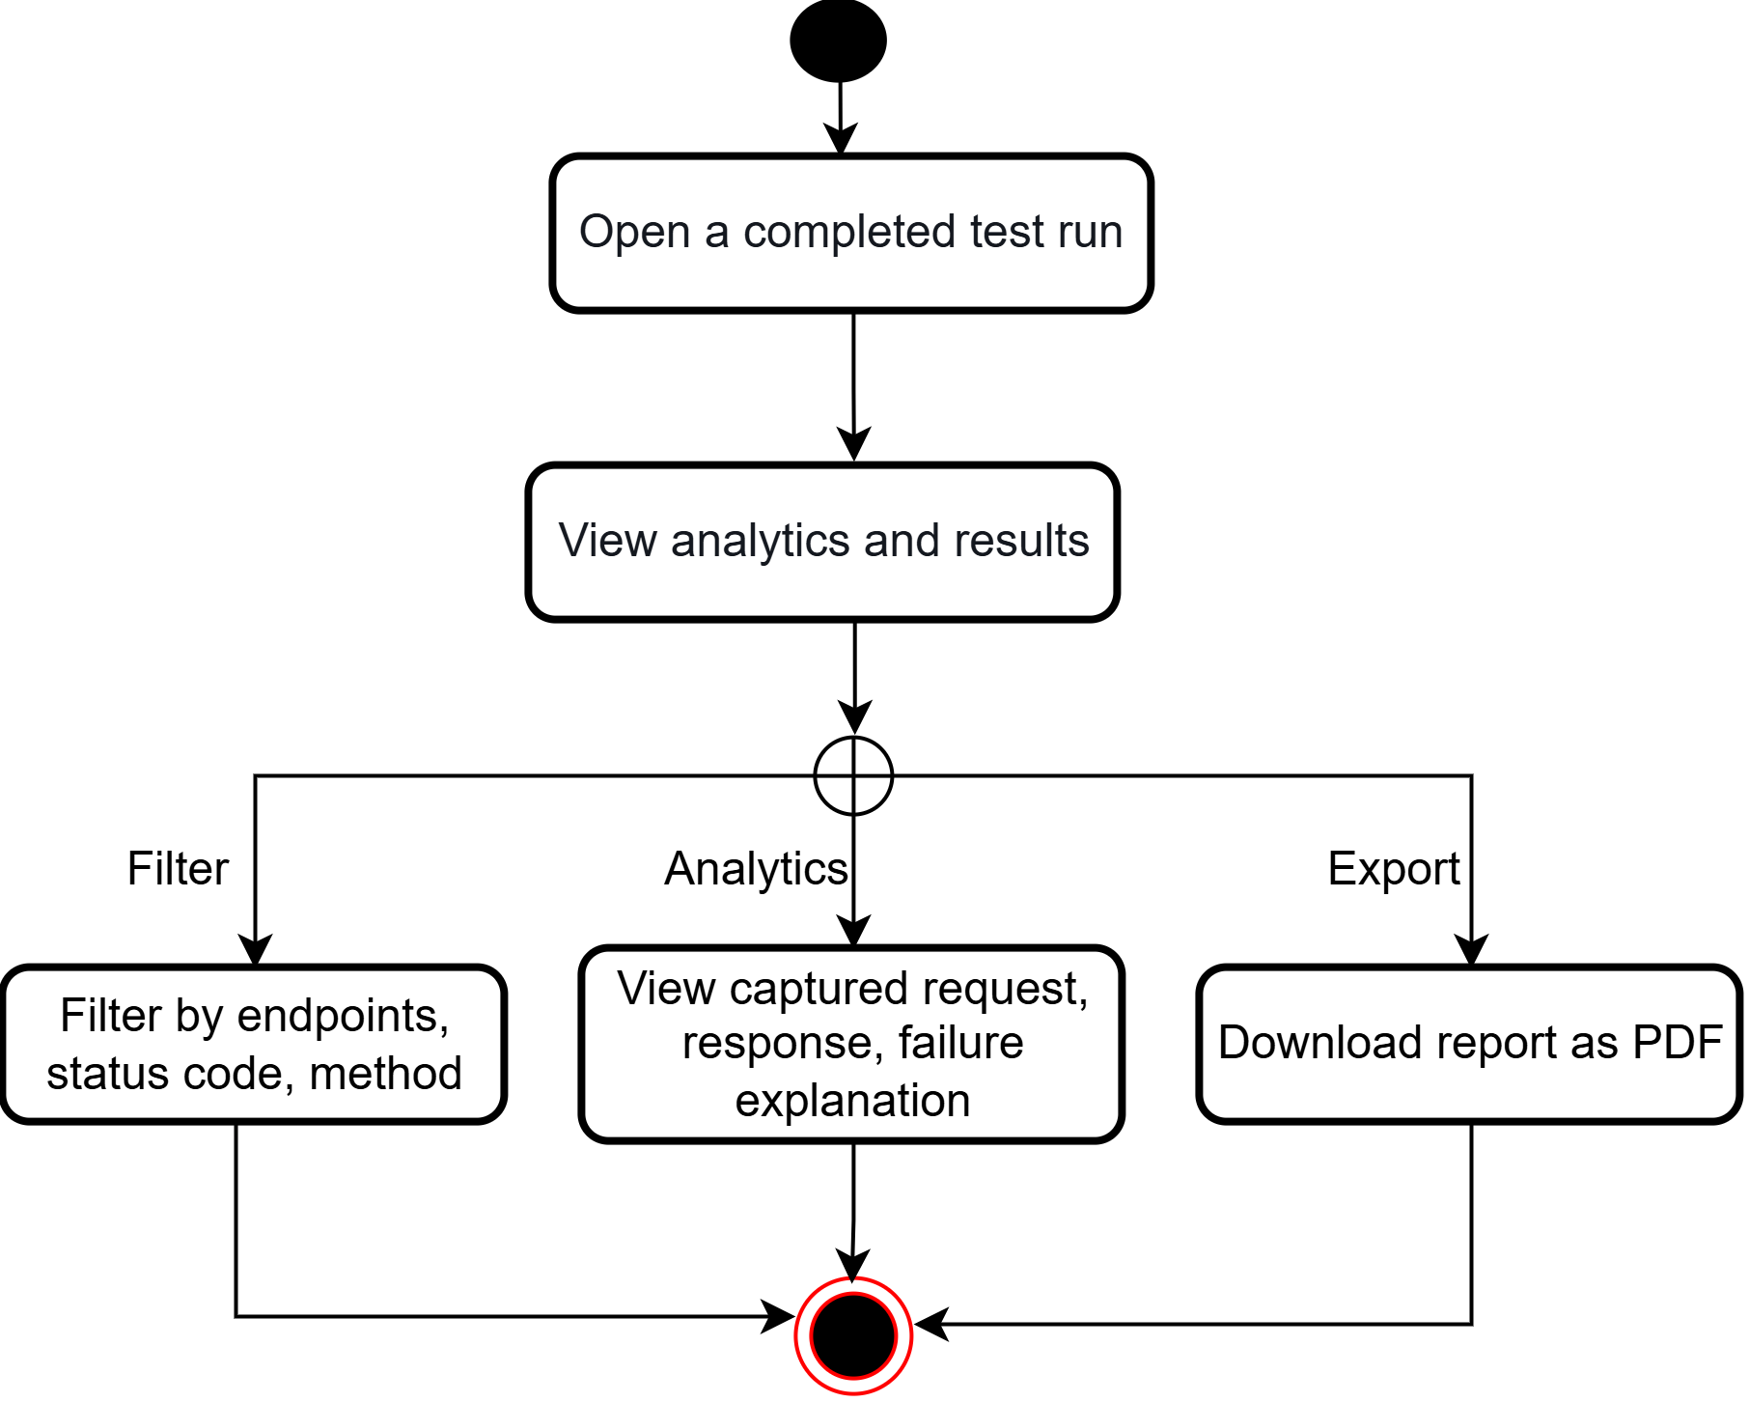
Activity Diagram Level 1.6 - Test Results & Reports
19

Slide 21
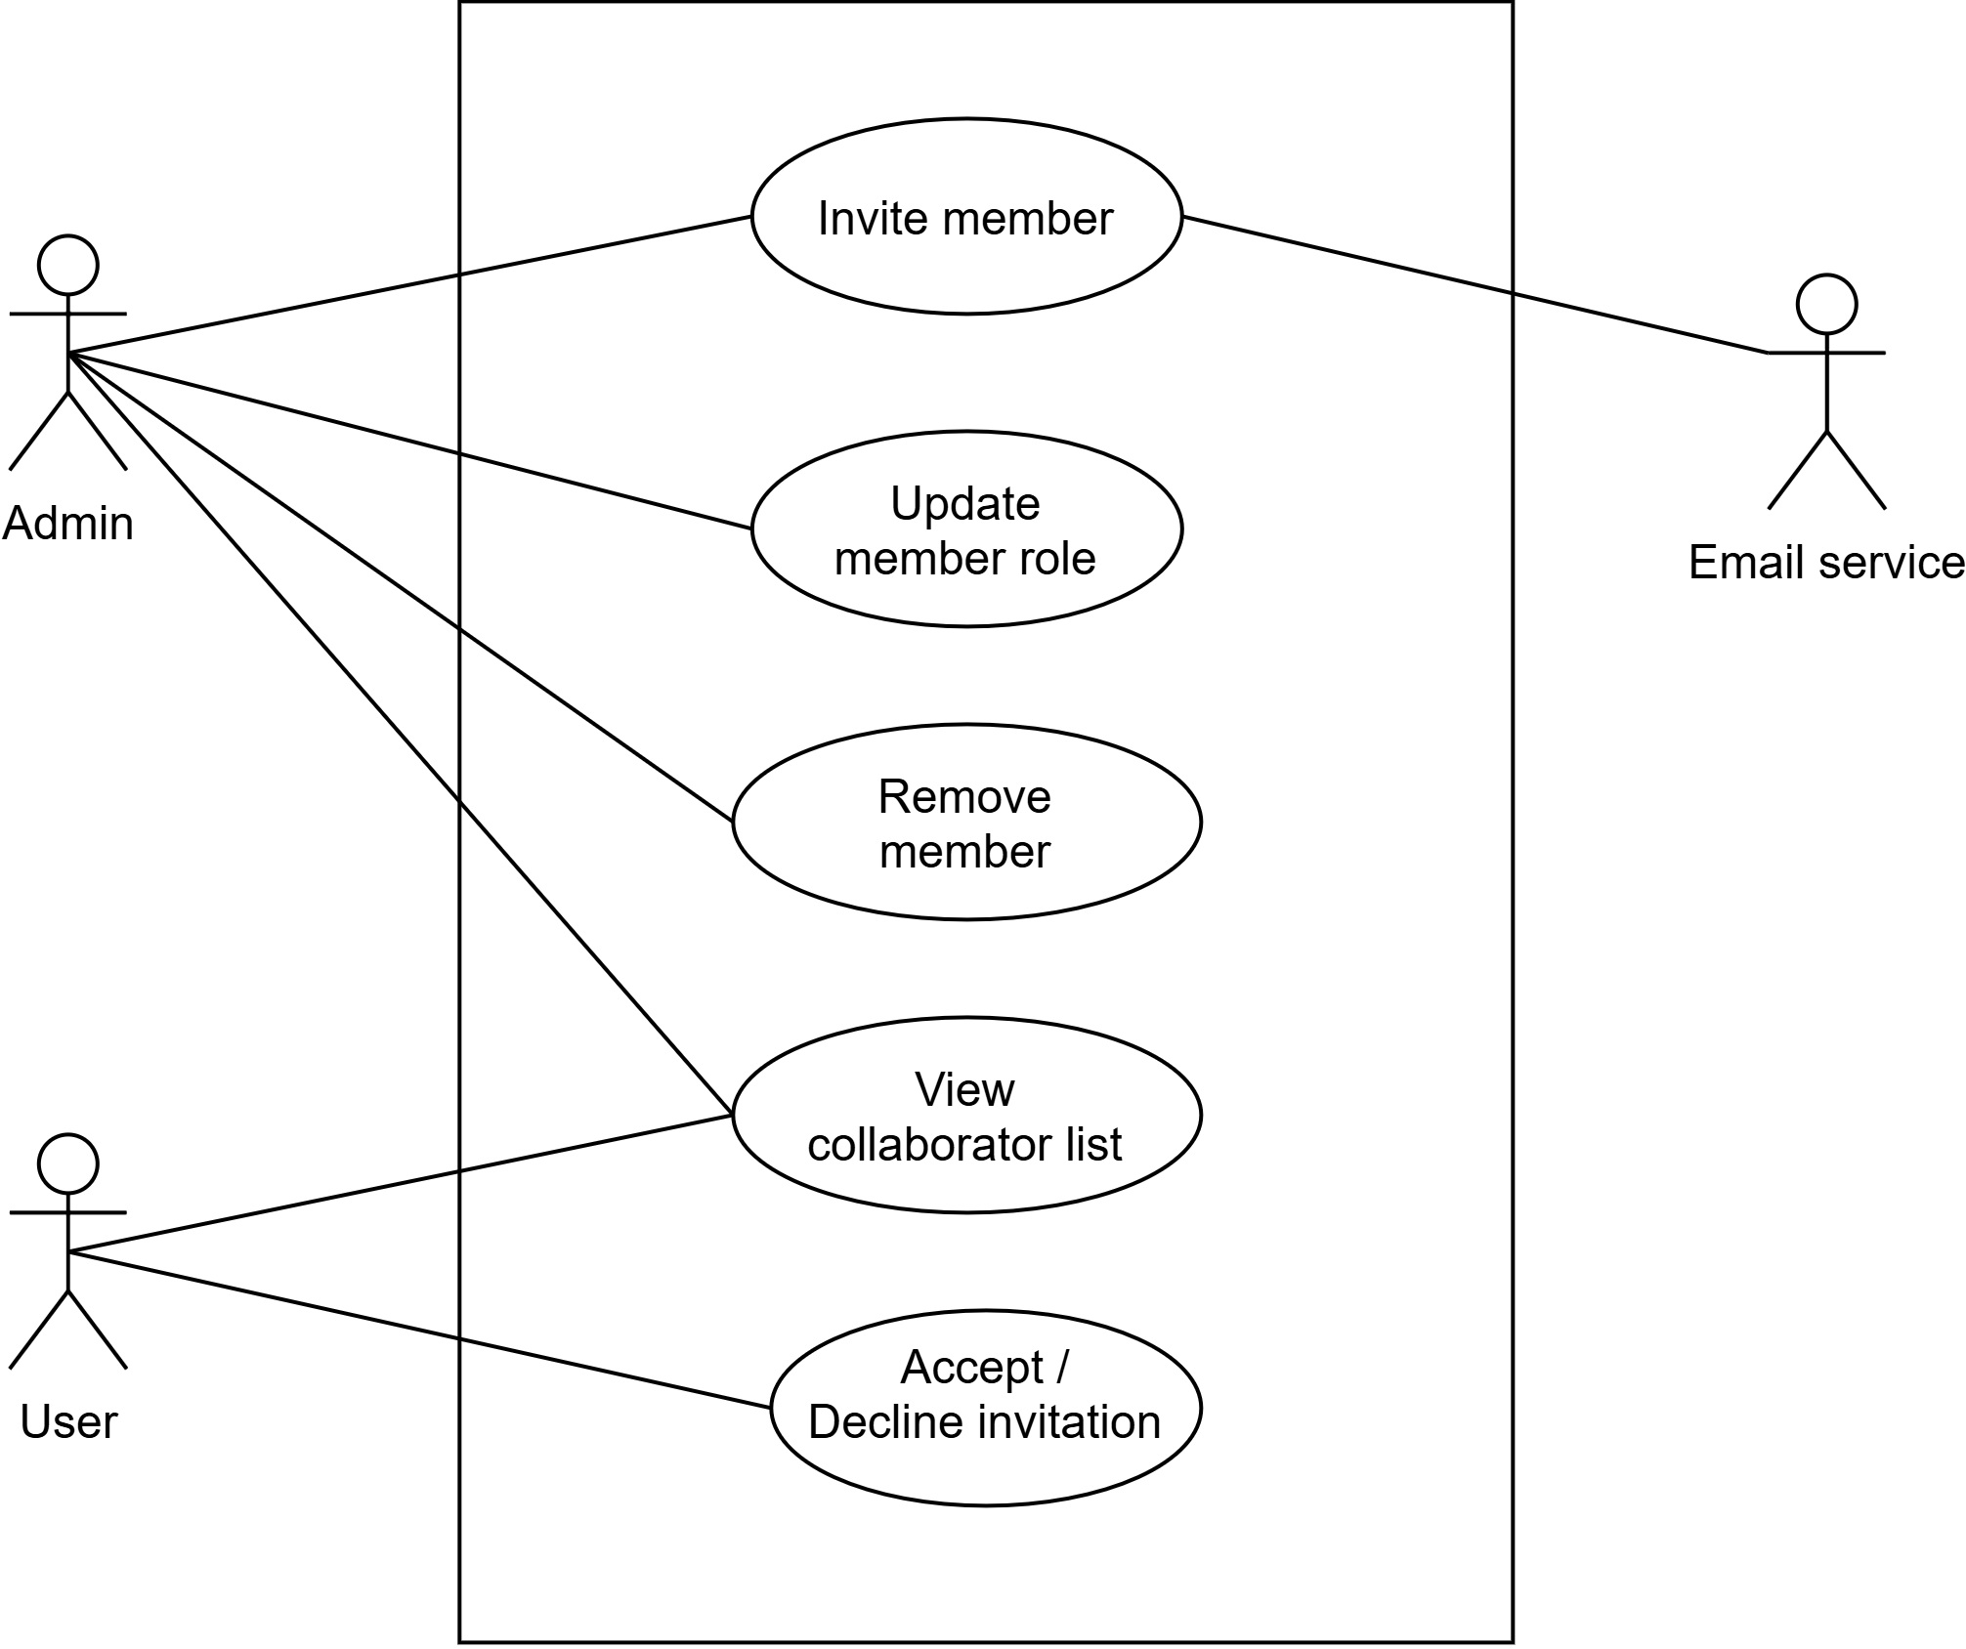
Use Case Level 1.7 - Team Collaboration
20

Slide 22
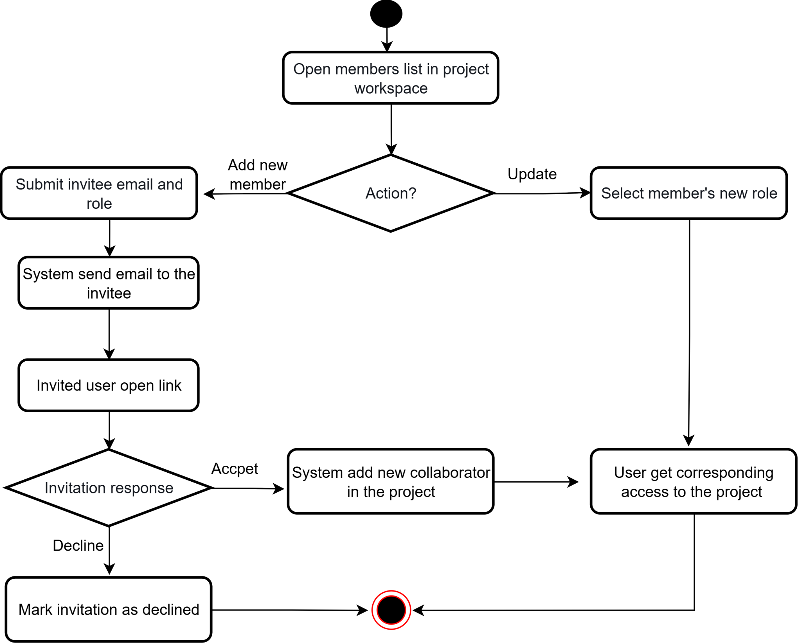
Activity Diagram Level 1.7 - Team Collaboration
21

Slide 23
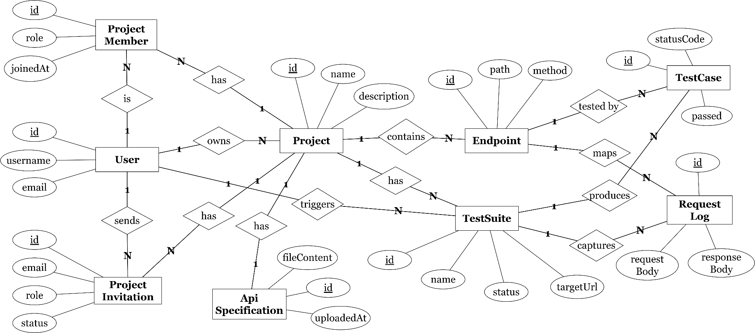
ER Diagram

Slide 24
Demo

Slide 25
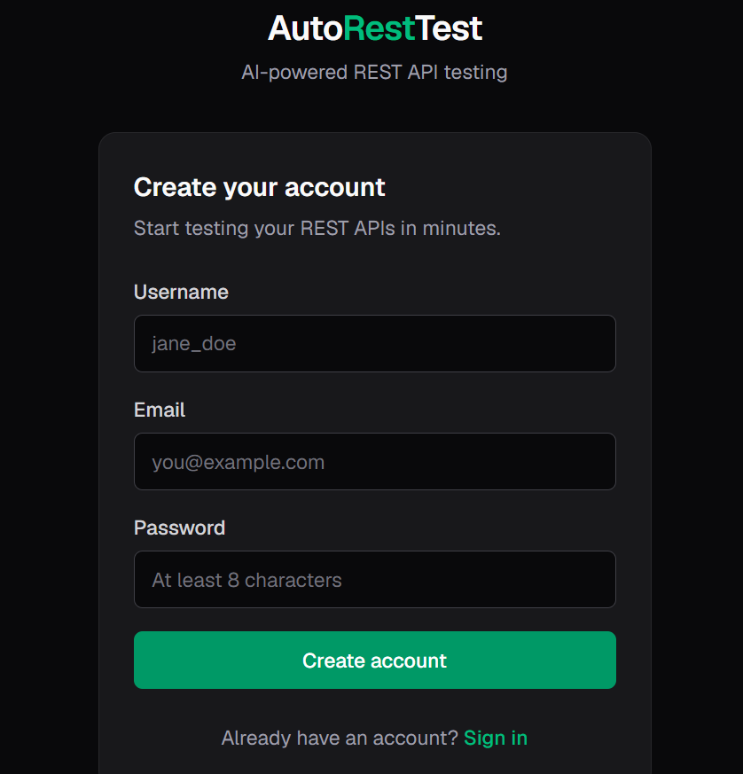
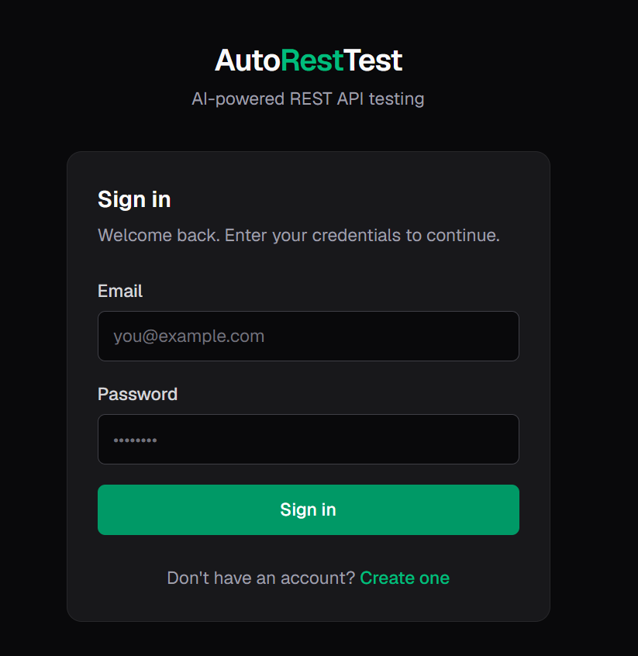
Authentication

Slide 26
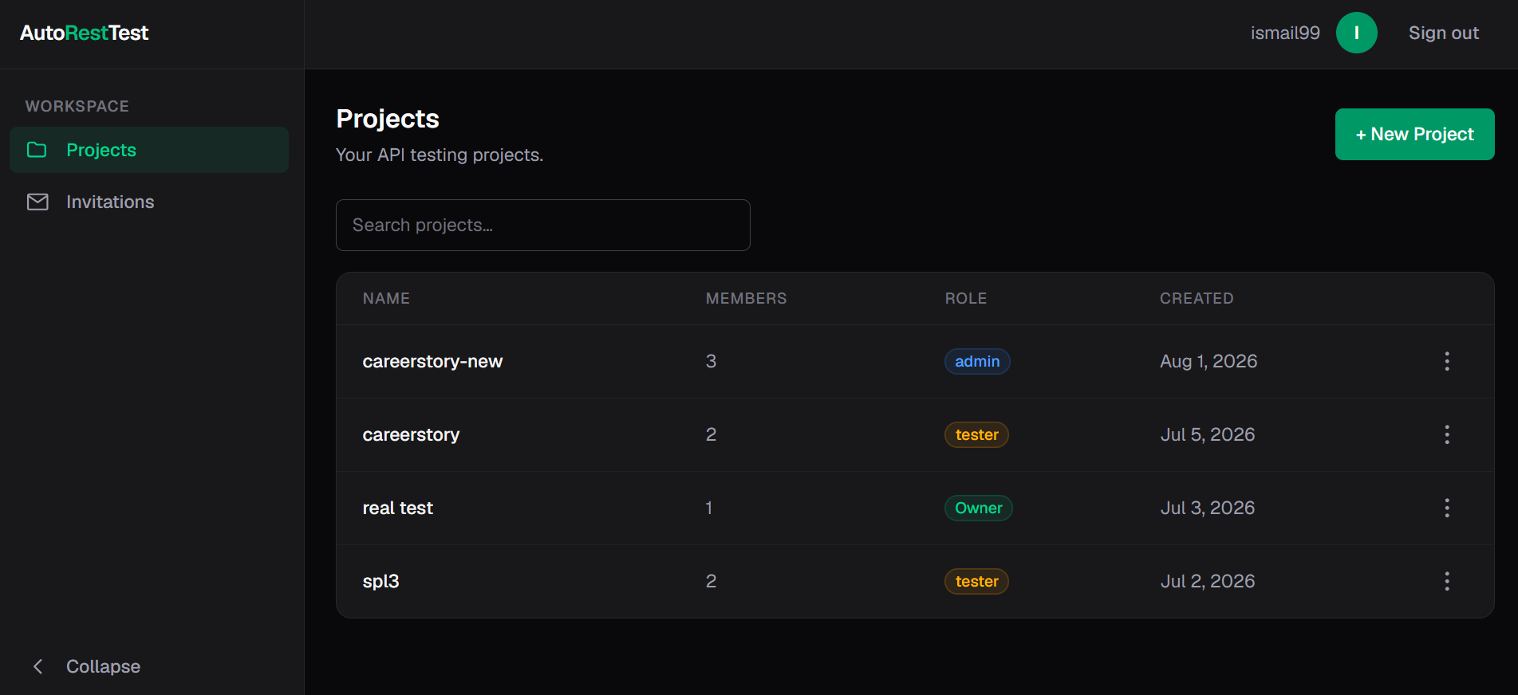
Homepage

Slide 27
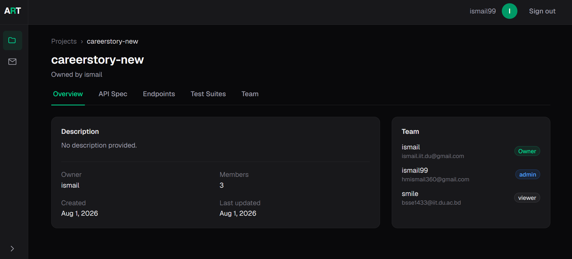
Project dashboard

Slide 28
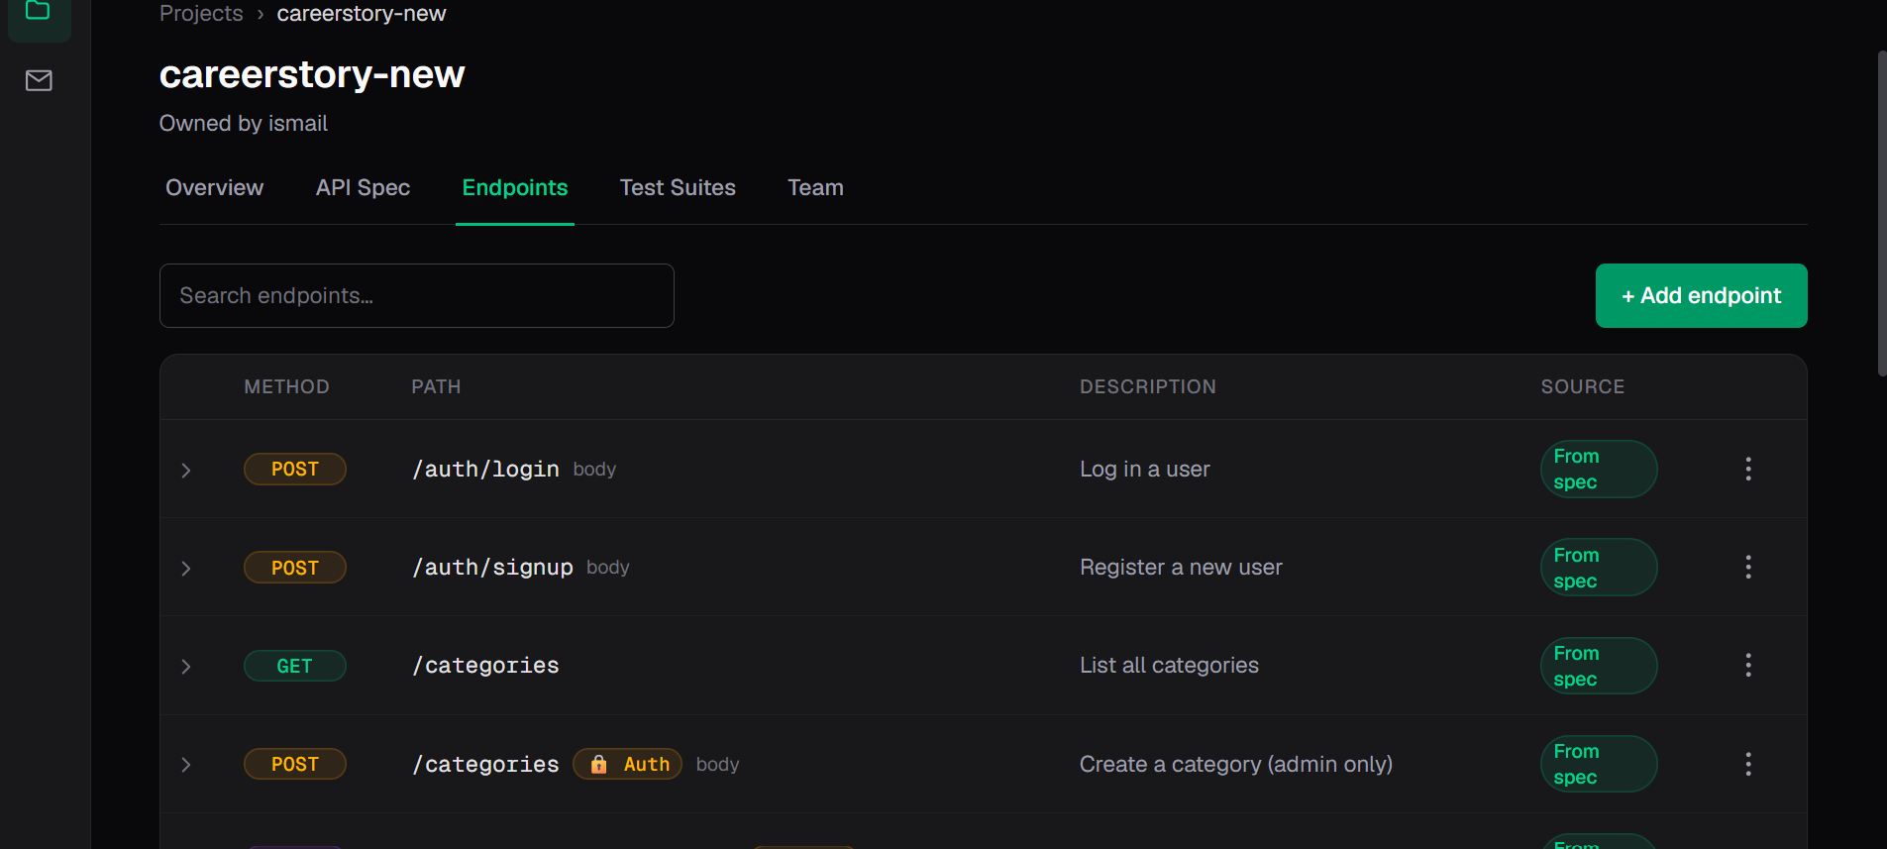
Endpoint list

Slide 29
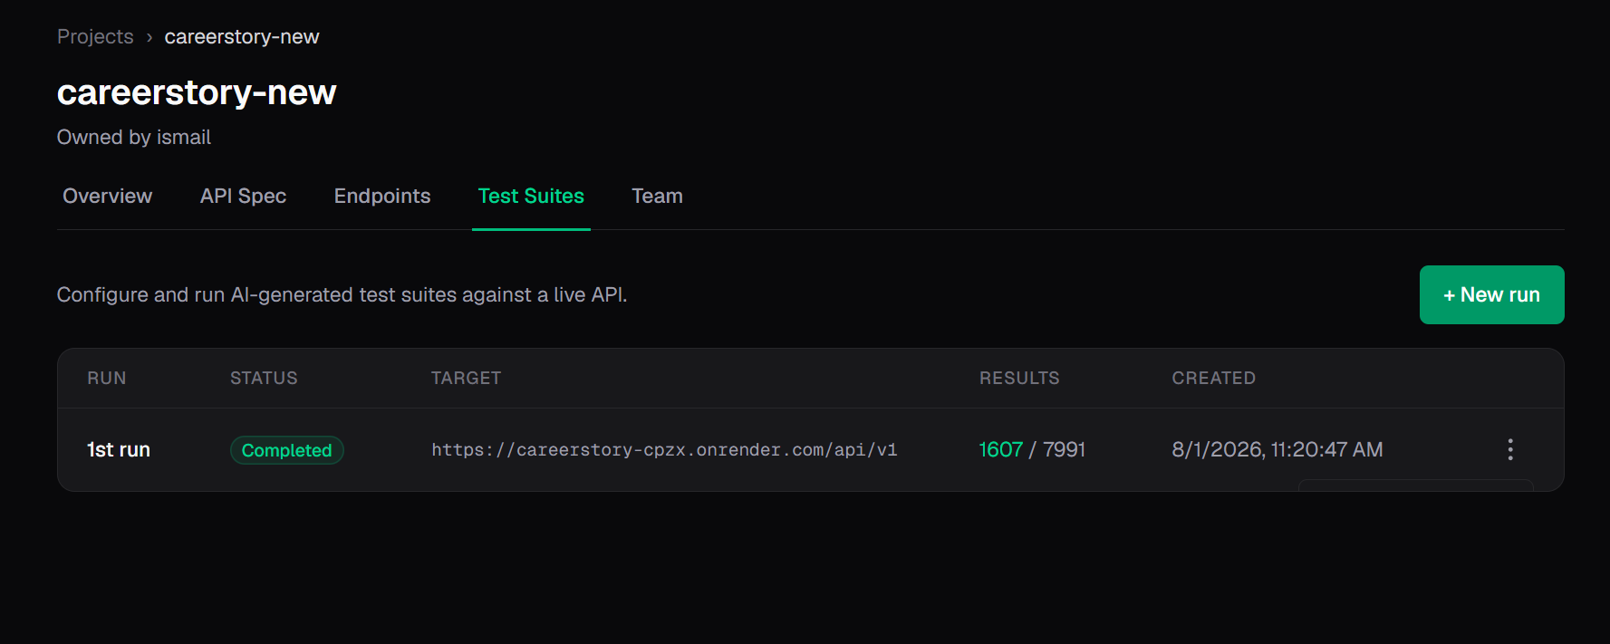
Test suite management

Slide 30
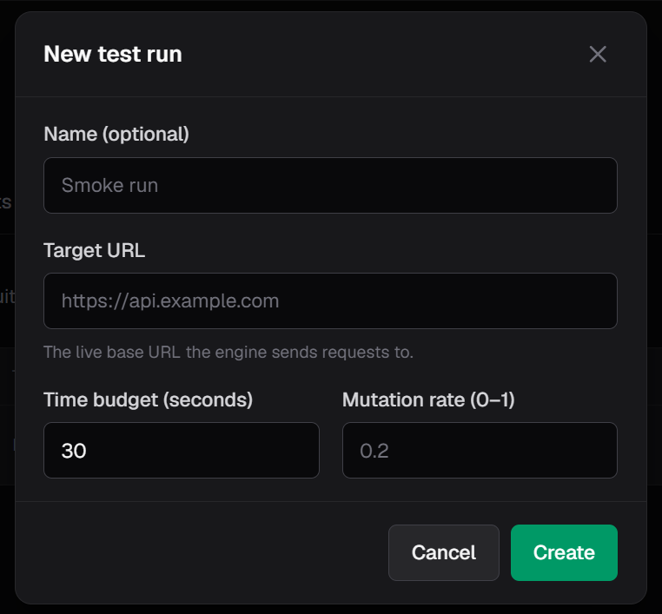
Test suite management

Slide 31
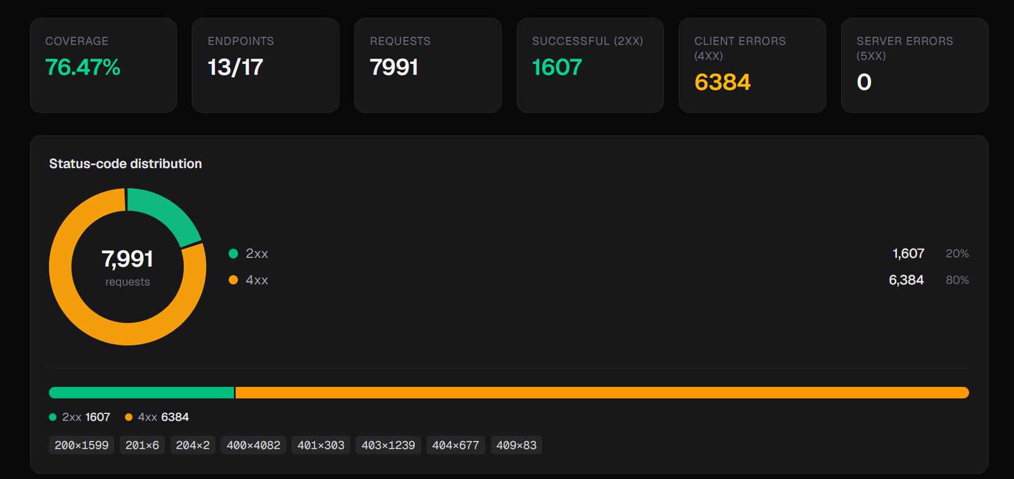
Test Results

Slide 32
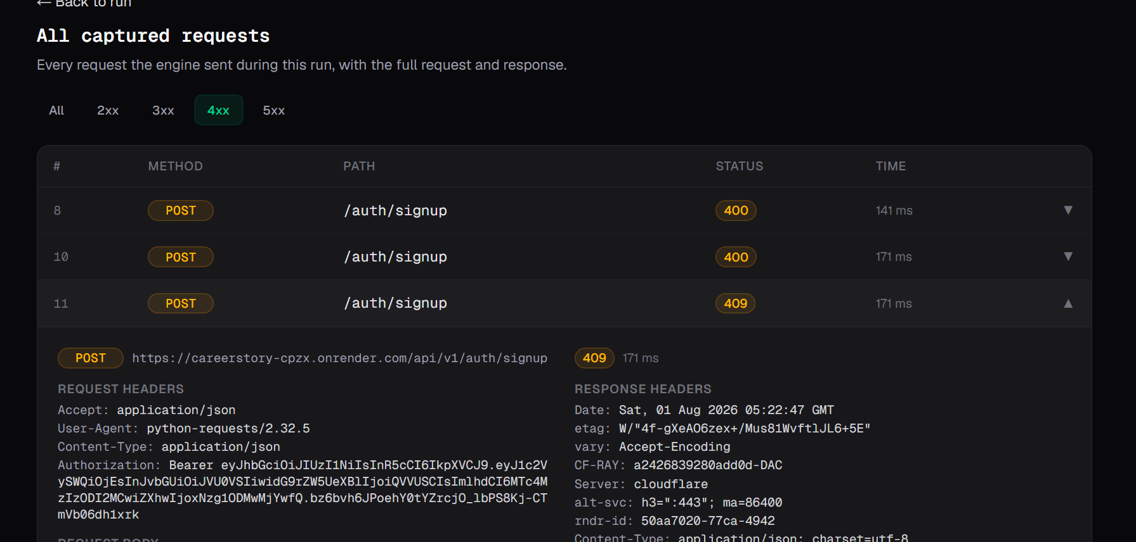
Test Results

Slide 33
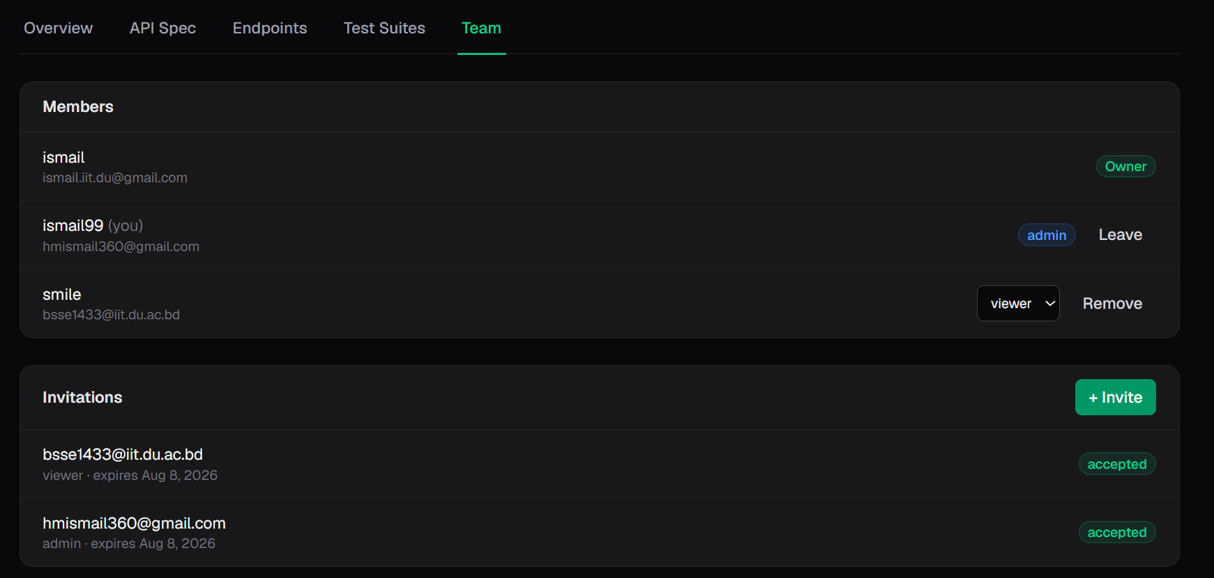
Team Collaboration

Slide 34
References
https://drive.google.com/file/d/1G-jta80F8JeALJ1X-nclVKVgbBlwR1H8/view?usp=sharing

